Slide 1
School Off
Using past data to anticipate school closure

Slide 2
Team Members
Trung Nghia Nguyen
Andrew Millian
Ryan Mccarthy

Slide 3
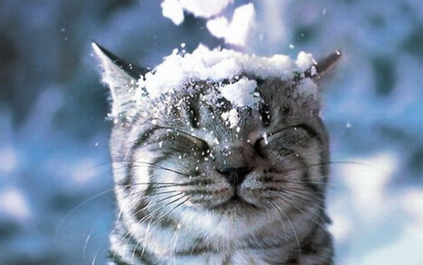
Problem
Bad Weather = Happy Students
But how can we be sure that school will close?
We want students to have the ability to see ahead of time when school is going to be closed. To do this our goal is to develop an app that uses past weather data in order to predict future school closings.

Slide 4
Background Information
Machine learning is the practice of using automated models to determine the relationship between different variables.
Different kinds of machine learning, such as supervised and unsupervised learning.
Neural Nets is a type of unsupervised machine learning using simple processing units called neurons.

Slide 5
Data Gathered
Accu Weather has historical data to find out the weather in any day in the past 20 years.
However, it isn’t free, so we switched to weather underground, which has all the data we need..
George mason has recorded school closings and delays dating back to 2007.
This includes early cancellations.

Slide 6
API
OpenWeatherMap
Difficulty

Slide 7
Factors
Temperature
Precipitation
Accumulation
Previous day's weather accumulation
Wind strength

Slide 8
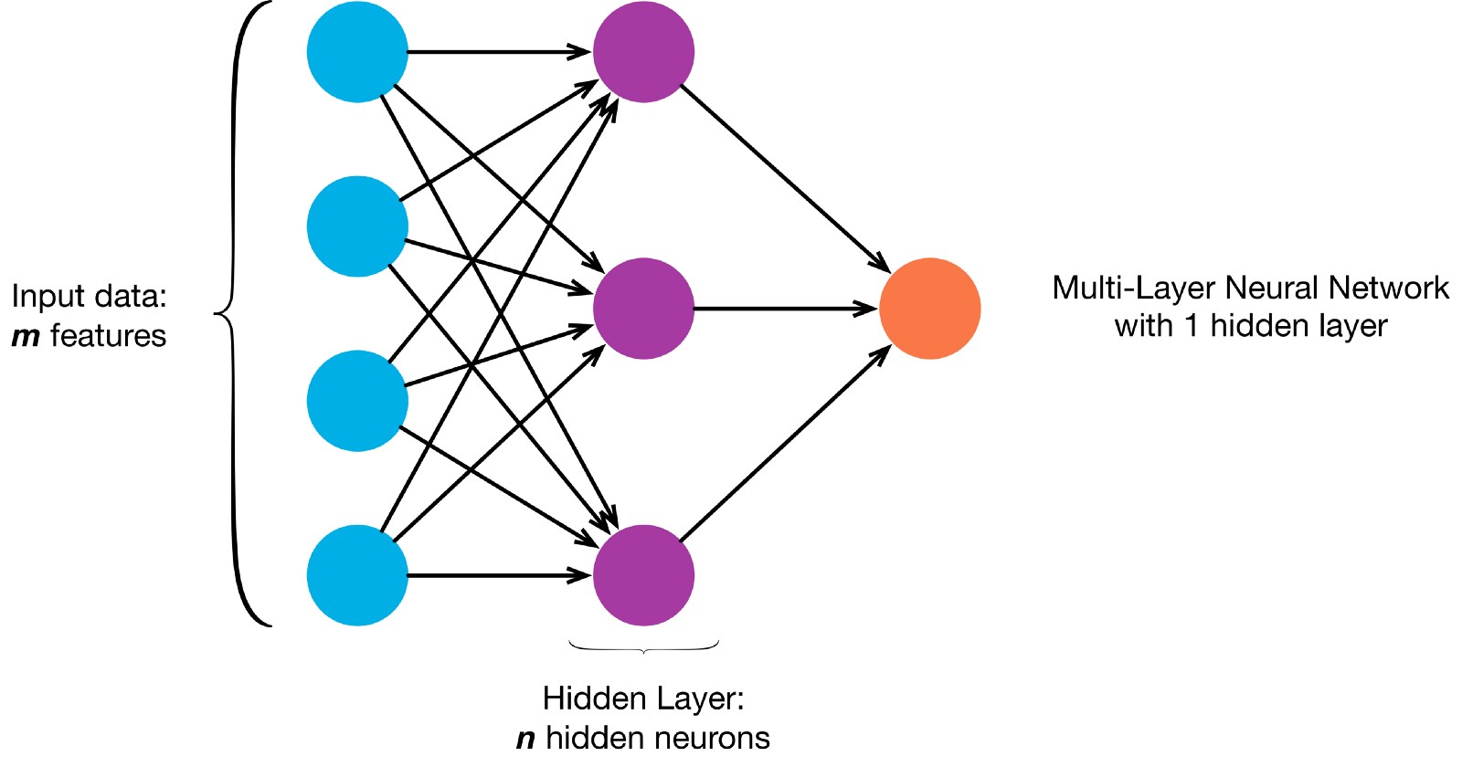
Algorithm

Slide 9
Algorithm Cont.
Our app is using a two layer neural network with back propagation. The network is trained using data from previous days weather along with information on whether or not school was closed/delayed.
The network is initialized with random edge weights and tries to guess the correct outcome on a given training set vector. Once the network makes a guess it compares that guess to the actual outcome associated with the training set vector, and modifies the edge weights in order to better predict future outcomes.
The end result is a network of edges and nodes that will be able to accurately predict delays and closings.

Slide 10
Algorithm Cont.
Train data using multiple sets, containing a large number of delays, cancellations and free days. Our vectors consist of <temperature, humidity, wind speed, precipitation type, amount of precipitation, previous days precipitation type, previous days precipitation amount>
We use a set of data of about 50 days consisting of days off and control days to train our net. Using back propagation our network will correctly “weight” how much each input vector parameter is affecting having a day off.
Ensure data sets have a wide variety of free days. (IE: don’t have snow days and summer exclusively.)
Run on sequestered data to check for accuracy.

Slide 11
Neural Net Weights V
(4.7013874 -4.7174378 -1.0369709 -4.956034 2.5164626 0.5604324)
(-1.5886842 -0.38823006 -1.631562 -1.2673955 0.53925777 0.6615484) (-1.9173675 -0.34544966 -1.5111042 -1.4408562 -0.8266896 -0.003480704) (-1.3548119 0.17843686 -1.452835 -1.6177709 -0.7073143 0.47258297) (-1.8377072 -0.25232753 -2.2538448 2.1703732 -1.424829 -2.0900054) (0.23770707 0.62467766 1.3459951 6.8916216 4.0529995 0.7274381) (-5.260584 0.6071666 -3.2904344 8.359922 -5.615922 -2.371472)
(2.5081337 -11.754191 0.8108118 3.8488455 -3.0932854 1.6069659) (-3.087058 -0.098526515 -2.3476894 1.5305188 3.125813 0.123444475) (-0.49285176 3.219892 1.057497 -11.691372 -11.871463 -3.7923734) (-2.0161963 -0.7169333 -2.0390017 1.02494 0.96613497 -0.40423346)

Slide 12
Neural Net Weights W
(-5.7572065 -0.14543024 -0.26810464 0.33025634 -1.6753031 2.559705 -7.2792063 10.256568 1.90281 -7.403379 -0.15245272)

Slide 13
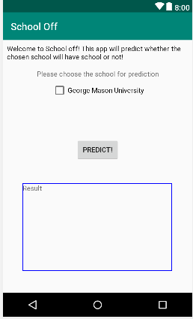
Android Application

Slide 14
Results
Test Data.
Day | 12/4 | 12/5 | 12/6 | 12/7 | 12/8 | 12/9 | 12/10 | 12/11 | 12/12
Prediction | Open | Open | Open | Open | Open | Open | Open | Open | Open
Actual | Open | Open | Open | Open | Open | Open | Open | Open | Open

Slide 15
Challenges
OpenWeatherMap API: Successfully imported
School Closing Reason Data: Found.
Android Application: Functional
Reliability and Availability: Mean error mean error of 0.005031323
Runtime Performance: Runtime is short.

Slide 16
Future Improvement
Add more schools
Access payed repositories for more/better data.
Reverse the problem, use a neural net to make the decision impartially, rather than predict the decision.

Slide 17
Questions?

